Slide 1
Autonomous Machine Programming Cost of Faults in Products Non-volatile memory Solutions Group (NSG)
Joe Tarango (RAAD Principal Investigator, Telemetry 2.0 Architect, Machine Learning Scientist, & Adjunct Professor CU Boulder)
Team:
Daniel Garces, Rogelio Macedo, Sungkeun Kim, Stella Cao, PanteA Zardoshti, Tyler Woods,
Andrea Chamorro, Zachery Zimmerman, Brad MacDonald (Penn Intern on loan from IL), Jim Baca, Prasanna Rupasinghe
NPSG/IOG Collaborators: Randy Eike, Phuong Tran, Don Verner, James Gourley
Strong Collaboration with Intel Labs Machine Programming Research (MPR):
Justin Gottschlich (Principal AI Scientist & Director of Machine Programming Research) & Niranjan Hasabnis (CF Dev), MPR Team
Notes:
Hello Everyone,
I would like to take the opportunity to present a joint effort with many supporters.The technologies are based in storage and are transferable to other adjacent technologies. Many of these technologies are patent pending being Intel exclusive technologies.

Slide 2

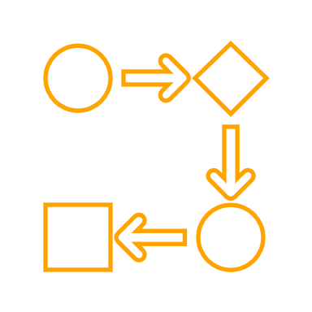










Problem Statement
Our debug/root cause and fix velocities are too slow
~6.5 days of effort to resolve each bug (spread over several weeks)
Our SSD devices are complex
Analysis (root-cause) requires a broad and deep understanding of FW/system
FW developers must spend time understanding context of bug or seeking expert council
Large number of issues to resolve strains expert availability
(Example) ADP program to date has seen just over 3,000 bugs
Hard to predict drive failures (asserts, perf, power, …)
We’re usually test-and-check
Notes:
In today’s performing state, it takes 6.5 days of effort to resolve bug and the timeframe to resolve it can linger for several weeks. The challenge is the resolution at its core is due to complexity of relational polices, mechanisms, exchanges, and events. As a consequence, the resolution requires a broad and deep understanding to address these faulting and anomalous states. The most optimized approach to solve these challenges are to develop task forces consisting of experts in various domains. To provide a background on the volume of the a given product program, we queried JIRA and were surprised to see over 3000 observed total bugs as of last week. The sheer volume explains the limited availability of experts and these were exposed through our continuous validation testing. The resolution of these were typically completed through the cycle of development, experiment, and re-testing with predicting outcomes ahead of time being on the order of complexity to solve the bug.
The impact of saving 0.1 person days of effort per bug (i.e. 0.8 person hours). Would yield 2,400 hours saved (0.8 person hours times 3,000 = 2400 person hours). When taking these into account a highly productive work week of 40 hours, we see on the order of 60 engineering weeks saved.

Slide 3






Environment Observation and Hypothesis
Observation
We are people, resource, and time constrained for BU expectations
Hypothesis
We can amplify our expert(s) capabilities and influence through automation
Agent(s)
Action(s)
State(s), Reason(s)
Situation(s)
Assessment(s)
Notes:
To summarize the findings of observation, we can see the active state shows a slow bug closure velocity, missed SLAs, and stretched project milestones/PRQs (David Roymoder). The takeaway is we are people, resource, and time constrained for the sustainable growth of the BU. The hypothesis is if we can amplify our expert’s capabilities and influence through automation then we can meet the expectations of the business unit entering the market sooner for our products.
An additional note is today, we do not have the ability to provide analytical confidence in product degradation without empirical execution. The human driven feedback has not been consistent; thus automation enables stabilization in resolution.

Slide 4
Customer Telemetry Fault Resolution Time Reduction from Quality Data

Slide 5
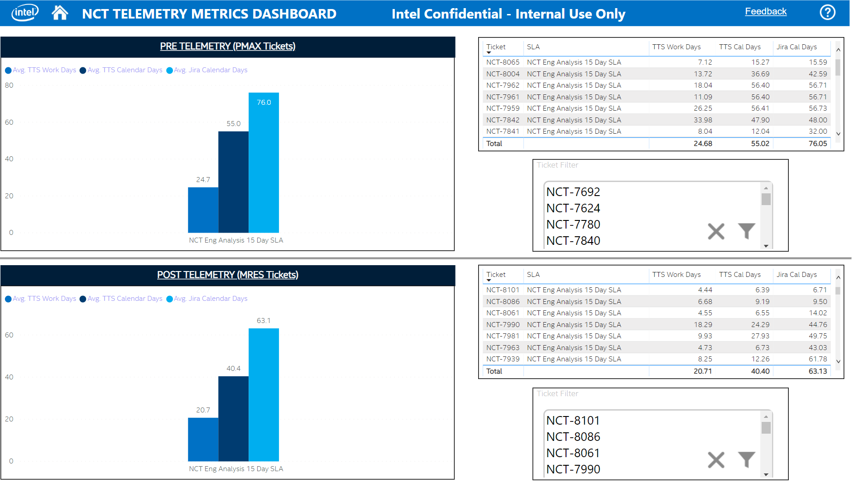
Data Dell PMAX vs. MRES Case Study
Using Telemetry speeds up transition from Issue to FW Eng Backlog
48 Hour Initial issue feedback to 14-day RCA is now feasible
Improved quality of NCT’s to hand off to Eng Backlog
Higher number correctly targeted NCTs
Better first level analysis using improved Triage Tools
Faster customer feedback responses possible
Confirmation of duplicate issues now turned around in a single day
Requiring RMA of drives from customer now the Exception vs POR
goto/NCTTelemetryDashboard
17.9%
Reduction
With more data, we have observed 17.9% Time reduction on customer turnaround.

Slide 6
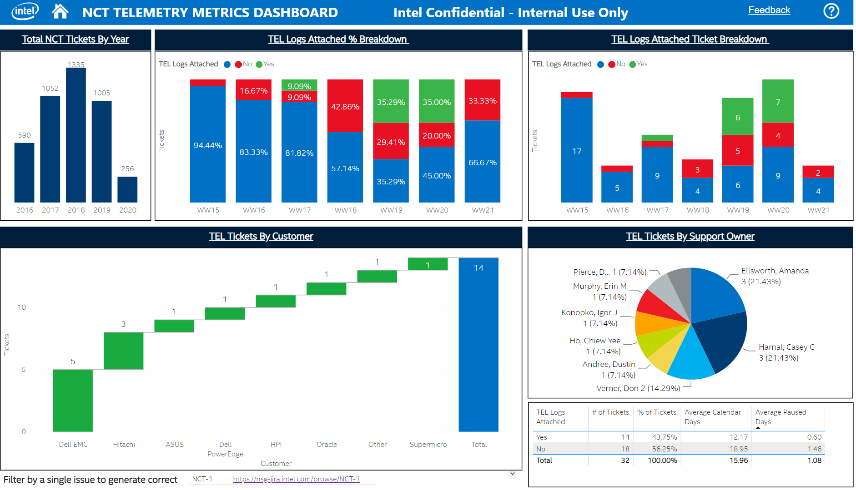
Telemetry Metrics Dashboard
Telemetry speeds up Issue to Eng Backlog transition
Improves quality of NCT’s to hand off to Eng Backlog
Faster customer feedback responses possible → NCT-8094
Requiring RMA of drives from customer now the Exception vs POR
Training Resources & Access
Telemetry 2.0 training (NSG FW/SW Eng. Common Training)
Telemetry 2.0 Video Training
NCT Telemetry Metrics Dashboard (goto/NCTTelemetryDashboard)
For access to dashboard, request “HVPO_Dashboards_PBIRS_Viewers” in AGS
38.8%
Reduction
With increased meta data, customer resolution time continues to decrease with data 35.8% from last snapshot.

Slide 7
Comprehending the Costs of Code and Faults Focusing on development improvements

Slide 8
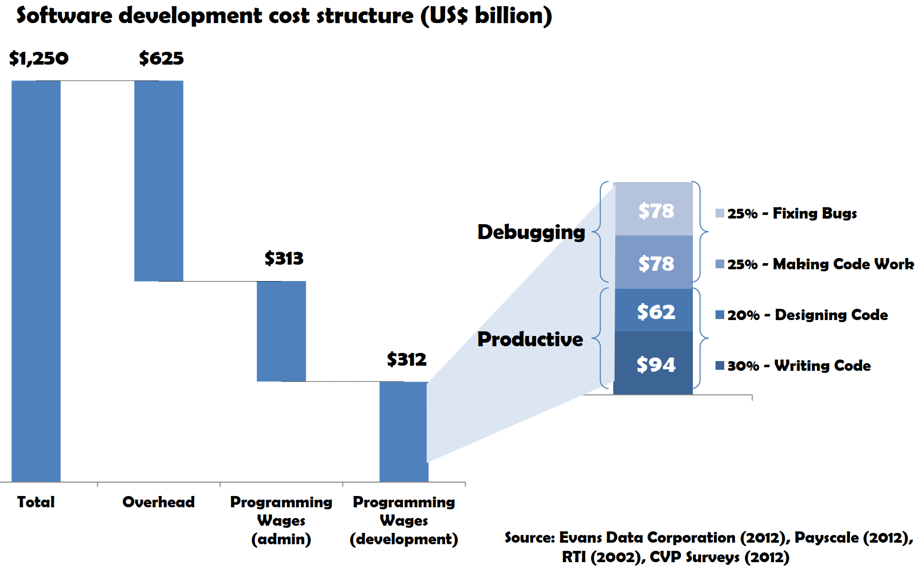
Quantification of the Global Costs Associated with Development
University of Cambridge Case Study
US$156 Billion per year Wages-only estimated cost of debugging
US$312 Billion per year TOTAL estimated cost of debugging including wages and overheads
Programmers Time
50.1% General Tasks & Development
49.9% Debugging
Projected Outcome(s)
Effective debugging technique(s) can save 26% in debug time
Net Global Savings Potential $81 Billion
Bottomline
We have opportunities
Fault Analysis Root Causing and Repair is Substantial Globally.
Reference: Britton, T., Jeng, L., Carver, G., Cheak, P. & Katzenellenbogen, T. (2013) Reversible Debugging Software: Quantify the time and cost saved using reversible debuggers
Source: Evans Data Corporation (2012), Payscale (2012), RTI (2002), CVP Surveys (2012)
Notes:
To start off the discussion, I wanted to show a study from Cambridge related to cost for developing software. In the context of our firmware systems today; we are closer trending to complexity in software design. The focal point of the slides is to highlight the necessary overhead associated with debugging costing nearly 1.56 Billion across the world. If we apply to projection to the expenses in NSG, we have significant opportunity to refocus developer time onto future technologies amplifying the growth potential.
*According to 54 questionnaire responses to the CVP survey and 11 interviews, based on the question ‘what percentage of your time is spent programming (e.g. designing, writing, testing, debugging etc.) compared with other tasks (e.g. admin, meetings, sales, etc)?’ Other tasks were then grouped as ‘admin’. **According to 54 questionnaire responses to the CVP survey and 11 interviews, based on the question ‘Of the time spent programming, what percentage of your time is spent on the following: (1)fixing bugs (2)making code work (3)designing code (4) writing code.’ (1) and (2) then were grouped as debugging.

Slide 9






Business Unit: Software and Defect Cost Estimates
Planning
US $1,000 to develop each line of code on the space shuttle
Red Hat Linux has been estimated to cost $33 lines of code (loc)
Defects cost 10 to 100 times more to fix when they escape detection during the coding phase.
Reducing defects or defect time
A conservative estimate -10% or reducing $1.50 per line of code represents a return of approximately 30 to 1
Architecture
Product Definition
Development
Test
Debug
Qualification
Release
In-Field
Reference: https://www.ghs.com/articles/GHS_dont_ignore_static_analysis_2_08.pdf
Product Code development is expensive!
Notes:
Presenter: Joe

Slide 10
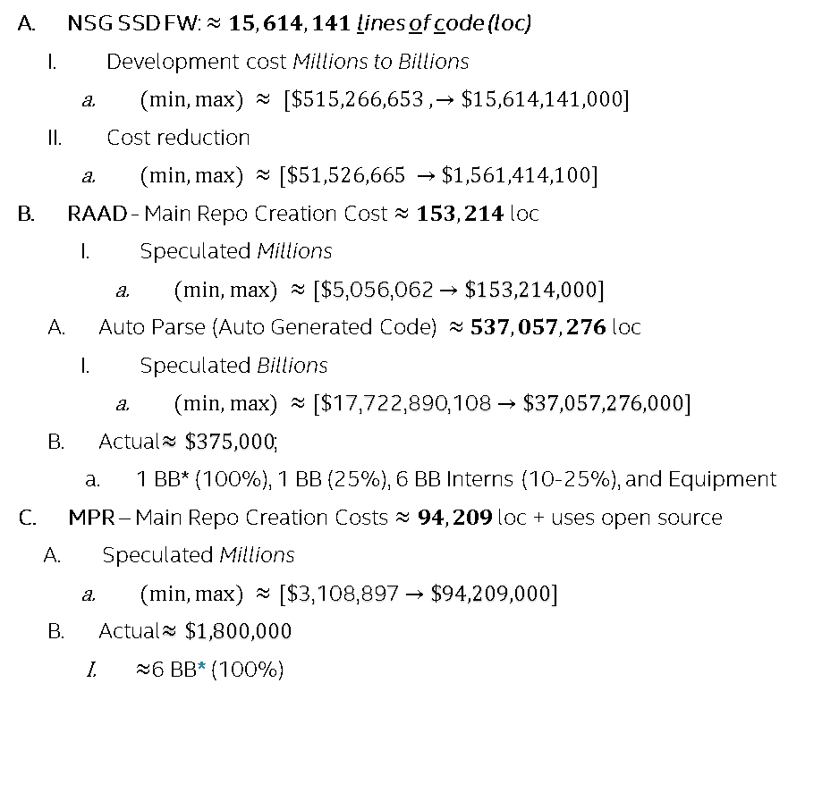

Business Unit: Acceleration Code Development Costs & Savings
Planning
NSG SSD FW: $≈15,614,141$ lines of code (loc)
Development cost Millions to Billions
$(min, max) ≈ [\$515,266,653 ,→\$15,614,141,000]$
Cost reduction
$(min, max) ≈[\$51,526,665 →\$1,561,414,100]$
RAAD - Main Repo Creation Cost $≈153,214$ loc
Speculated Millions
$(min, max) ≈[\$\text{5}\text{,}\text{056}\text{,}\text{062}→\$153,214,000]$
Auto Parse (Auto Generated Code) $≈537,057,276$ loc
Speculated Billions
$(min, max) ≈[\$\text{17}\text{,}\text{722}\text{,}\text{890}\text{,}\text{108}→\$37,057,276,000]$
Actual$≈\$\text{375,000}$;
1 BB* (100%), 1 BB (25%), 6 BB Interns (10-25%), and Equipment
MPR – Main Repo Creation Costs $≈94,209$ loc + uses open source
Speculated Millions
$(min, max) ≈[\$\text{3}\text{,}\text{108}\text{,}\text{897}→\$94,209,000]$
Actual$≈\$1,800,000$
$≈$6 BB* (100%)
Architecture
Product Definition
Development
Test
Debug
Qualification
Release
In-Field
*Top Performing (Unicorn) AI/ML scientists
$$\left[\$300 K → \$500K→\$1.8 M →\$120 M+\right]$$
https://www.nytimes.com/2018/04/19/technology/artificial-intelligence-salaries-openai.html
RAAD+MPR could save millions & millions, per year!
Notes:
Presenter: Joe
Linux: git ls-files | xargs wc –l
Windows:
(for /r %f in (*.c*) do @type %f ) | find /c /v "“
for /f tokens^=* %i in ('where/r . *.c;*.cpp;*.h;*.py;*.pl; *.gpj;^|find/v /c ""')do @echo\ %i

Slide 11
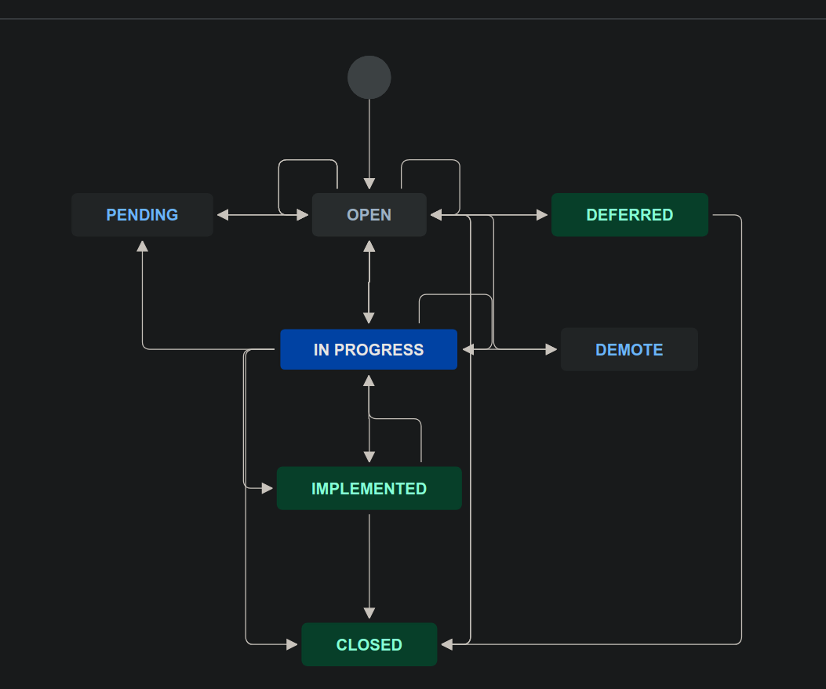
Development Time (Dev Time) Spend: Preparing for Data Mining
Literature Review of Atlassian JIRA subsystem
Annotated states and transitions
Enumerated paths significant for comprehension
Discovery: Open → Pending
Root Cause: Open → In Progress
Fix: In Progress → Implemented
Fix Verified: Implemented → Closed
How did we gather data?
Construct custom calculation to sum hours
Considered tasks and sub-tasks for each state transition time frame
Use Atlassian Application Programming Interface (API) work hours estimate
* When a fix is not complete the data maybe conflicting due to loop backs from implemented to closed. Therefore, more statistical analysis could be necessary to clarify correlation.
No analysis method existed so we created a path!
a
b
c
*
d
Query: issuetype = Sighting AND Program in(*)

Slide 12
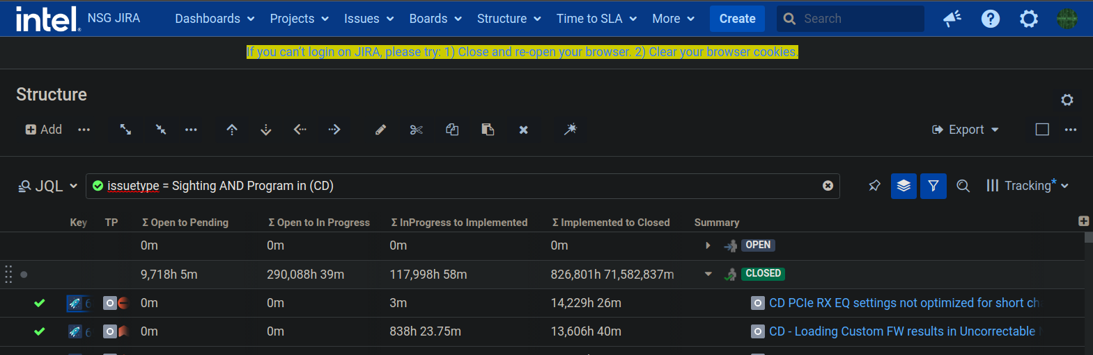
Dev Time: Atlassian Application Programming Interface (API)
Our analysis method uses estimation API to tune in actual work hours across the organization.
How did we gather data?
Construct custom calculation to sum time to each state transition activation
Consider tasks and sub-tasks for each state transition time frame
Use Atlassian Application Programming Interface (API) work hours estimate

Slide 13
Product Family: Data Labels and Mining
Observation(s)
TV, FD, and DV data appears to be incomplete
All families appear to see approximately 1000 faults
PDR appears to be bottlenecked by verification
CD, CDR, YV appear to be the be bottlenecked by expertise
YVR appears to have required significant firmware changes
Known(s)
TV is the refactor generation 3 of firmware
FD is the first Intel NVMe device
*R Represents media refresh with PDR being the first 3D stacked memory
Each set is an ASIC generation: {TV, FD, PDR, DV}, {CD, YV, CDR, YVR}, {GD, ADP}
YV/YVR’s SoC has many hardware escapes with technical communication disagreements on media requirements
High Level Label |  | Discover | Root Cause | Fix | Verified | All States
Program | Faults | Σ Open to Pending | Σ Open to In Progress | Σ InProgress to Implemented | Σ Implemented to Closed | Total Work Hours
TV | 1001 | 0 | 0 | 2 | 15323 | 15325
FD | 550 | 0 | 2057 | 64284 | 1208774 | 1275115
PDR | 1002 | 400 | 852 | 47483 | 1009660 | 1058395
DV | 1002 | 0 | 3130 | 79104 | 125000 | 207234
CD | 998 | 9718 | 290088 | 117998 | 826801 | 1244605
YV | 997 | 37924 | 245527 | 118577 | 298705 | 700733
CDR | 998 | 5968 | 220422 | 135003 | 134707 | 496100
YVR | 1000 | 14399 | 163282 | 180478 | 248590 | 606749
GD | 993 | 1109 | 61542 | 116767 | 268341 | 447759
ADP | 992 | 1678 | 156753 | 145864 | 163174 | 467469
All | 9533 | 71196 | 1143653 | 1005560 | 4299075 | 6519484
1
1
3
1
4
4
4
2
5
Observations and knowns show “Tribal” intuition.
Notes:
Fun facts:
PDR, DV was the only product bring in revenue for years with the delay in CD, YV.
PDR was the first version of robust firmware able to handle highly defect 3D media (80-60% of the media was defective in the first batches from manufacturing)
DV was used to sell slower media since SATA is bottlenecked by the interface where the higher binned media was sold in PDR.
PDR was able to win Amazon in competition to Samsung due to novel firmware algorithms.
GD was the first attempt at a low power NVMe SSD
ADP is an extension of GD with double the resources
CD and YV were the largest setback in NSG’s history.

Slide 14
Product Family: Retrospective Concerns
Speculations of meta data
Products such as: TV, FD, and DV could indicate the justification for uniform process procedures
Database upgrades are potentially incomplete and should have planned upgrade paths verifying data
Process inconsistencies or learnings are not uniform across product families
Low root cause time could indicate strong expert engineering sources for other programs to learn from.
Meta data samples of products during development could indicate how to align ratio of engineers with Root Cause to Verification
High Level Label |  | Discover | Root Cause | Fix | Verified | All States
Program | Faults | Σ Open to Pending | Σ Open to In Progress | Σ InProgress to Implemented | Σ Implemented to Closed | Total Work Hours
TV | 1001 | 0 | 0 | 2 | 15323 | 15325
FD | 550 | 0 | 2057 | 64284 | 1208774 | 1275115
PDR | 1002 | 400 | 852 | 47483 | 1009660 | 1058395
DV | 1002 | 0 | 3130 | 79104 | 125000 | 207234
CD | 998 | 9718 | 290088 | 117998 | 826801 | 1244605
YV | 997 | 37924 | 245527 | 118577 | 298705 | 700733
CDR | 998 | 5968 | 220422 | 135003 | 134707 | 496100
YVR | 1000 | 14399 | 163282 | 180478 | 248590 | 606749
GD | 993 | 1109 | 61542 | 116767 | 268341 | 447759
ADP | 992 | 1678 | 156753 | 145864 | 163174 | 467469
All | 9533 | 71196 | 1143653 | 1005560 | 4299075 | 6519484
1
1
3
1
4
4
4
2
5
Expansion of intuition based on magnitudes.

Slide 15
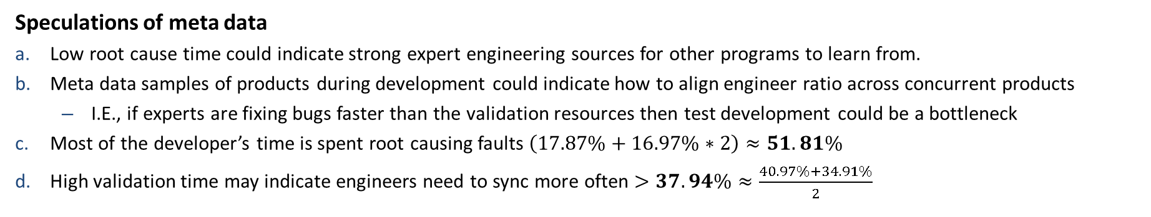
Product Family: Meta Data Indicators
Speculations of meta data
Low root cause time could indicate strong expert engineering sources for other programs to learn from.
Meta data samples of products during development could indicate how to align engineer ratio across concurrent products
I.E., if experts are fixing bugs faster than the validation resources then test development could be a bottleneck
Most of the developer’s time is spent root causing faults $\left(17.87\%+16.97\%∗2\right)≈51.81\%$
High validation time may indicate engineers need to sync more often $>37.94\%≈\frac{40.97\%+34.91\%}{2}$
High Level Label |  | Discover | Root Cause | Root Cause to Fix | Fix Verified
Program | Faults | Σ Open to Pending | Σ Open to In Progress | Σ InProgress to Implemented | Σ Implemented to Closed
TV | 10.50% | 0.00% | 0.00% | 0.01% | 99.99%
FD | 5.77% | 0.00% | 0.16% | 5.04% | 94.80%
PDR | 10.51% | 0.04% | 0.08% | 4.49% | 95.40%
DV | 10.51% | 0.00% | 1.51% | 38.17% | 60.32%
CD | 10.47% | 0.78% | 23.31% | 9.48% | 66.43%
YV | 10.46% | 5.41% | 35.04% | 16.92% | 42.63%
CDR | 10.47% | 1.20% | 44.43% | 27.21% | 27.15%
YVR | 10.49% | 2.37% | 26.91% | 29.75% | 40.97%
GD | 10.42% | 0.25% | 13.74% | 26.08% | 59.93%
ADP | 10.41% | 0.36% | 33.53% | 31.20% | 34.91%
All | 0.15% | 1.09% | 17.54% | 15.42% | 65.94%
Average | 10.00% | 1.04% | 17.87% | 18.84% | 62.25%
Standard Deviation | 1.49% | 1.71% | 16.97% | 13.38% | 26.72%
Minimum | 5.77% | 0.04% | 0.08% | 0.01% | 27.15%
Maximum | 10.51% | 5.41% | 44.43% | 38.17% | 99.99%
Top 3 Average | 10.51% | 3.00% | 37.67% | 33.04% | 96.73%
Top 1-STD or Sigma Average | 10.51% | 3.00% | 37.67% | 33.04% | 47.48%
Normalization analytics to zones of developer work time.

Slide 16
Comprehending the Scope of Flaws NASA case study application *If precise meta data exists, we can apply the NPSG model to the seen faults.

Slide 17


Business Unit: Intel to NASA Model Translation
Planning
Requirements
Architecture
Product Definition
Design
Build
&
Test
Development
Test
Debug
Qualification
Release
Operation
In-Field
Translation of Intel development model to NASA Model.
Notes:
Presenter: Joe

Slide 18
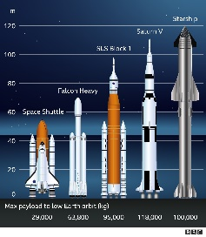
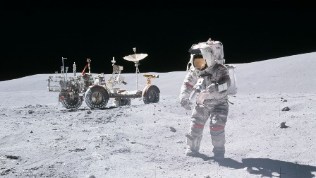
Field Statistical Study: Projections and Model
Performed literature review of over 100 publications
Findings indicated companies were not accurately reporting data
NASA Model is the only comprehensive study
Model used data sets to construct statical ranges of faults found
Each fault was estimated at all the typical product development life cycle phases
Faults in critical systems dramatically increase the cost
Cost of Escape
Minimum -> Maximum = 23 Million -> 16 Billion
Average Cost and Deviations per Life Cycle
Life Cycle Phase | Average | STD | 1-STD | 2-STD
Requirements | $22,632.00 | $31,510.00 | $54,142.00 | $85,652.00
Design | $87,832.00 | $70,191.00 | $158,023.00 | $228,214.00
Build | $354,808.00 | $381,953.00 | $736,761.00 | $1,118,714.00
Test | $1,370,888.00 | $2,638,785.00 | $4,009,673.00 | $6,648,458.00
Operation | $3,558,215.00 | $6,207,917.00 | $9,766,127.00 | $15,974,039.00
* Standard Deviation (STD), 1-STD represents the sample tail.
Using real data 1 faults is expensive.

Slide 19
Cost Analysis: Projection for a Single Flaw
Example analysis
Scenario
Flaw identified at requirements
Resolved at Operation
Product Cycle Phase
Requirements
$6K to $24K
Design
$23K to $59K
Build
$62K to $186K
Test
$124K to $633K
Operation
$646K to $2.9M
Total Cost
$864K to $3.8M
Cost of a single flaw if not solved promptly, will cost millions.

Slide 20
Estimating Cost Debug of a Program: ADP
ADP is the latest NAND PCIe gen 4/5
In the first slides, we verified from program mangers ADP has seen at least 3000 flaws.
When estimating the cost of a program on debug only…
Investment expanding historical meta data
Minimum -> $67 M
Average -> $199 M
Maximum -> $47 B
Variance
Poor performing ($162 M -> $696 M)
Catastrophic ($256 M to $2.4 B)
When deciding and planning for a program, we can make real-time decisions based on cost model and seen flaws.

Slide 21
Intel Labs: MPR Control Flag Collaboration

Slide 22
Finding Code Anomalies
What is a code anomaly?
A piece of code that is irregular
Why care about code anomalies?
Anomalous code can lead to defects, technical debt, delayed software development (hard to understand code)
MPR = Machine Programming Research

Slide 23



Existing Systems Can Identify Code Anomalies
Tools & techniques to identify software defects
Testing (unit tests, QA, etc.)
Static analysis
Compilers, linters (e.g., Coverity, Klocwork)
Limitations
Continuous manual effort to maintain and update (i.e., adding new rules as things evolve)
Manual efforts can be error-prone

Slide 24
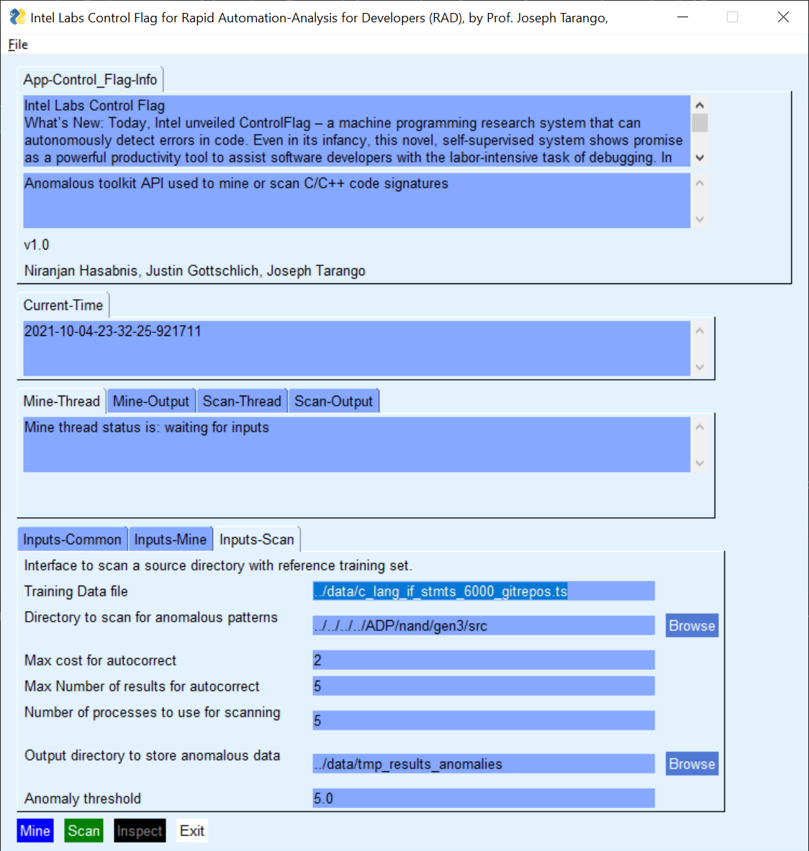
Intel Wide Collaboration Control Flag GUI: Production Code
What is Control Flag?
Statistical detection technique to identify and flag code fragments.
Uses control structures in code to construct statistical labels of norms and anomalies.
Training is done by learn from production quality code
Data set is over 6000 production repositories.
Analysis
Perform fault analysis of NSG’s production code base using control flag
Each fault was analyzed by developers & the faults were not found in state-of-the-art tools
362 detections
195 after automated de-duplication
102 real developer labels
Normalized and applied ratios from NASA model
I.E. If 102 faults were found from the rate ratio model
We think ControlFlag is a powerful new tool that could dramatically reduce the time and money required to evaluate and debug code. According to studies, software developers spend approximately 50% of the time debugging. With ControlFlag, and systems like it, I imagine a world where programmers spend notably less time debugging and more time on what I believe human programmers do best — expressing creative, new ideas to machines.”
– Justin Gottschlich, principal scientist and director/founder of Machine Programming Research at Intel Labs, https://www.intel.com/content/www/us/en/newsroom/resources/press-kits-labs-day-2020.html#gs.cfs58f
Found faults can be prevented by using Control Flag.

Slide 25
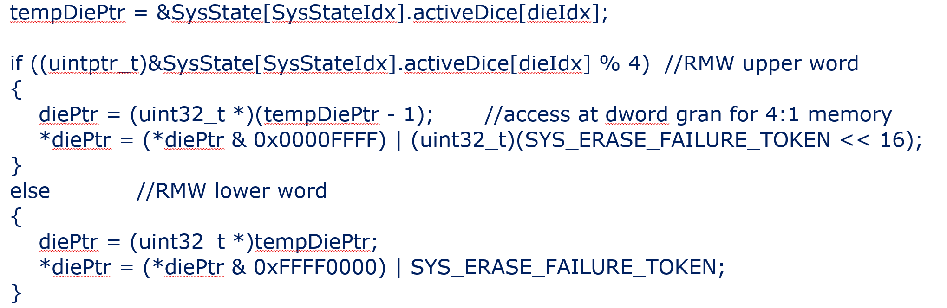
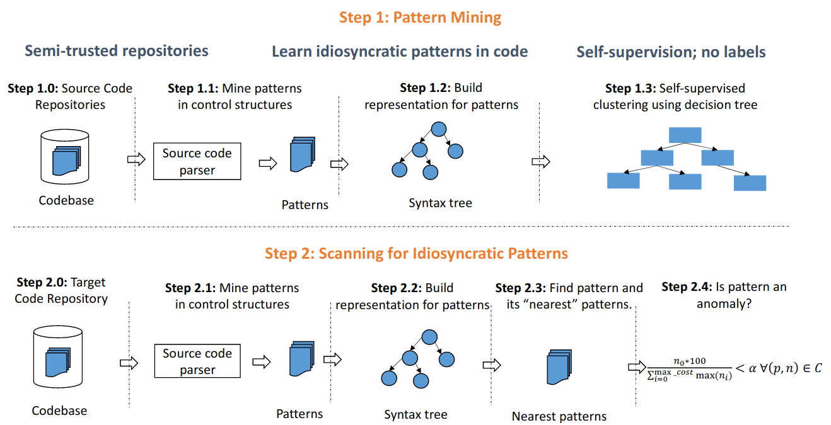
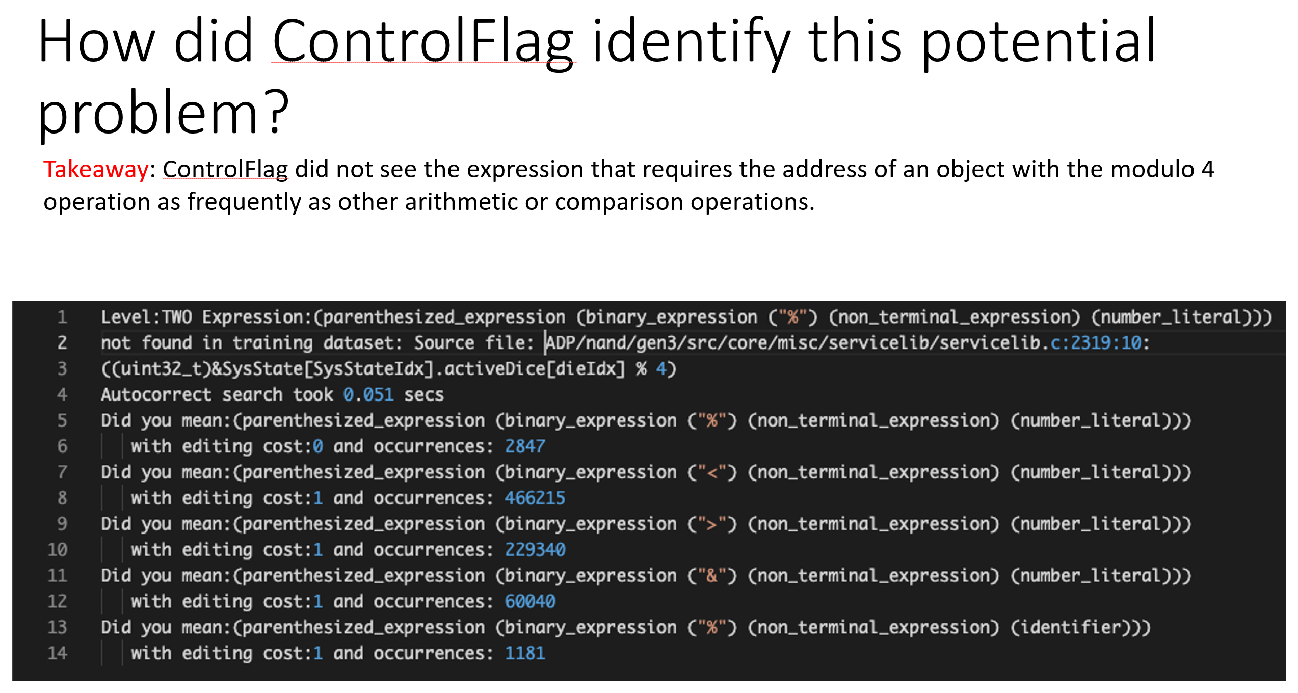
Machine Programming Research (MPR): Bug Detection ControlFlag
Ex. Potential memory error flagged
Automatically detects possible idiosyncratic and typographical errors in the control structures (static code analysis)
Learns good code control structures from opensource repositories and compares to code in target repository identifying possible anomalies
Inputs: Static targeted code base
Outputs: List of potential issues with targeted code base
Note:
If dieIdx set to 0 (data will be written before start of the array)
If the number of elements in the array are some odd number (data will be written past end of the array)
Evaluated potential memory error identified by Control Flag – found code is prone to error as written
Self-Supervised (No Labels) & Self-Evolving (Little Manual Effort)
Notes:
Hi Craig,
Great find! I agree with your analysis of the code and the findings that the code will break, if any of the following conditions are true:
If dieIdx could be 0 (writing before start of the array)
If the number of elements in the array are some odd number (writing past end of the array)
I initially flagged it as problematic because the code operates on certain assumptions (such as 4-byte alignment of activeDice array and dieIdx is not 0), none of which are enforced (e.g., assert or exceptions) in the code. At the very least, I feel that these assumptions should be enforced in the code.
Thanks,
Niranjan.
From: "Valine, Craig M" <craig.m.valine@intel.com> Date: Tuesday, August 17, 2021 at 1:50 PM To: "Baca, Jim S" <jim.s.baca@intel.com>, "Rupasinghe, Prasanna" <prasanna.rupasinghe@intel.com>, "Gottschlich, Justin" <justin.gottschlich@intel.com>, Niranjan Hasabnis <niranjan.hasabnis@intel.com> Subject: ControlFlag
Hey Niranjan,
I do not believe that this is a functional issue but the information to determine this needs context and constraints outside of the function being flagged. Here is a quick explanation (full code at end). At the very least the code is prone to future issues as written. With just the context of the function, I would consider an issue.
if ((uintptr_t)&SysState[SysStateIdx].activeDice[dieIdx] % 4) //RMW upper word
The above array is uint16. The %4 will return 0 or 2 depending on the element. The first element is a length. dieIndex will always be >0. Index zero is a length.
tempDiePtr = &SysState[SysStateIdx].activeDice[dieIdx]; <- Will always point to element 1 or greater
if ((uintptr_t)&SysState[SysStateIdx].activeDice[dieIdx] % 4) //RMW upper word <- This mod will return 0 or 2 (very confusing)
{
diePtr = (uint32_t *)(tempDiePtr - 1); //access at dword gran for 4:1 memory <- 2 byte aligned, This subtraction is fine as long as dieIdx not 0 which should not be the case.
*diePtr = (*diePtr & 0x0000FFFF) | (uint32_t)(SYS_ERASE_FAILURE_TOKEN << 16); <- Write upper bits after decrementing PTR
}
else //RMW lower word <- 4 byte aligned
{
diePtr = (uint32_t *)tempDiePtr;
*diePtr = (*diePtr & 0xFFFF0000) | SYS_ERASE_FAILURE_TOKEN; <- Writes lower 16 bits. Could potently run over end of array writing 0xFFFF if odd number of elements.
}
Very delicate code. Will break if
dieIdx ever set to 0 (currently length is set in entry 0 so should not occur). Result in access past start of array.
Array has odd number of elements. Results in access after end of array.
I see not reason why above code can not be replaced with 16bit access removing a sizeable chunk of code.
SysState[SysStateIdx].activeDice[dieIdx ] = SYS_ERASE_FAILURE_TOKEN;
void Nand_Work_System_Erase(uint32_t nandWorkId)
{
const uint32_t die = Nand_Work_GetDie(nandWorkId);
const uint32_t SysStateIdx = System_GetSysStateInstance(nandWorkId);
if (Nand_Work_HasError(nandWorkId))
{
const uint32_t numDice = SysState[SysStateIdx].activeDice[0];
uint32_t i, dieIdx = 0;
uint16_t *tempDiePtr;
uint32_t *diePtr;
for (i = 0; i < numDice; i++)
{ //find which dieIdx efail was on
if (SysState[SysStateIdx].activeDice[i+1] == die)
{
dieIdx = i + 1;
break;
}
}
tempDiePtr = &SysState[SysStateIdx].activeDice[dieIdx];
if ((uintptr_t)&SysState[SysStateIdx].activeDice[dieIdx] % 4) //RMW upper word
{
diePtr = (uint32_t *)(tempDiePtr - 1); //access at dword gran for 4:1 memory
*diePtr = (*diePtr & 0x0000FFFF) | (uint32_t)(SYS_ERASE_FAILURE_TOKEN << 16);
}
else //RMW lower word
{
diePtr = (uint32_t *)tempDiePtr;
*diePtr = (*diePtr & 0xFFFF0000) | SYS_ERASE_FAILURE_TOKEN;
}
}
Work_Container_DecCount(Nand_Work_GetContainer(nandWorkId), 1);
Nand_Work_PutEntry(nandWorkId);
}

Slide 26
Memory error caught by Control Flag
In NSG’s code
1. void func() {
2. uint32_t* p32;
3. uint16_t* p16;
4. uint32_t index = 0;
5. for(j = 0; j < ..; j++) {
6. if (array[j+1] == some_value) {
7. index = j + 1;
8. break;
9. }
10. }
11. p16 = &array[index];
12. if ((uint32_t) p16 % 4) {
13. p32 = (uint32_t*)(p16 - 1);
14. *p32 = (*p32 & 0x0000FFFF) | (uin32_t) (mask);
15. } else {
16. p32 = (uint32_t*) p16;
17. *p32 = (*p32 & 0xFFFF0000) | some_other_mask;
18. }
19. }
Where is the memory error?
At Line 13, p32 could (1) point to out-of-bounds memory, or (2) become NULL, leading to memory error and crash.
What is the function of the code snippet?
Gets address of some element of array containing 2-byte data;
Checks if that address is 4-byte aligned;
Decrements that address to point to previous element;
Writes to that address as 4-byte value
Memory error
p16 at line 11 could point to 0th element that is not aligned on 4-byte boundary. Line 12 is true for such case. Line 13 points to the element previous to 0th element, which does not exist.
NULL deref
if p16 has value 2, p32 in line 13 would be NULL.
Memory faults can break our telemetry data collection… these are dangerous!

Slide 27
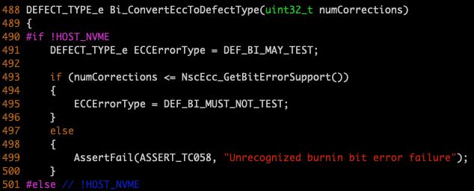
Anomalies that look like a bug: type error
uint32_t
uint16_t
Type issues can be silent logic bombs.

Slide 28
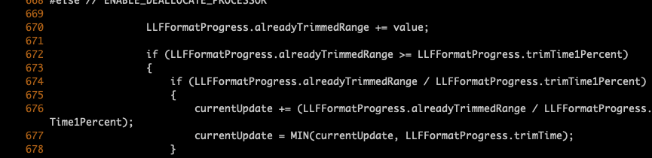
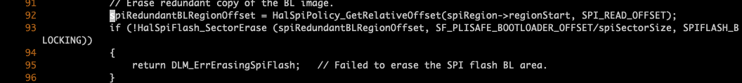
Possible divide by 0
Not checked for 0
Not checked for 0
Divide by zero has stop our product from shipping before!

Slide 29
Missing NULL check; missing return value check
Memory faults can break our telemetry data collection… these are dangerous!
(MVPBand_GetRefPendingDefragWLQ()->count)
(Nand_Work_IsBlank(GetNandWorkId()))
hdrPtr->timesWritten <= (UINT32_MAX-1))
(CMP_ReadFillPolicy(WCM_GetRMWHostCacheSlotCount()))
(pCmd->common.extendedPio == true)
Missing return value check; function call within a function call.
API faults will cause invalid cases forcing the module to fail!
Missing NULL check.
Can cause SR002 or full system crash.

Slide 30
Not using named constant; constant on right hand for equality
Magic numbers and typos can cause real issues and were not caught in code review.
/// @todo pass 'size'? I think so..
if (AreResourcesAvailableForDefrag(0))
{
return CMP_ALLOCATE_BUFFER;
}
(Work_Container_DecCount(MVPErsm_GetContainer(), 1))
(quiesceComplete == true)
(sectorOffset == (plane + 1) * MVP_SECTORS_IN_PAGE)
(outofRange == true)
(0x800000000 < expectedMaxNumSectors)
Constants on right hand of equality.
Prevent accidental assignment!
Not using named constants.
Magic numbers add technical debt.

Slide 31
Cost Analysis: Anticipated Range
Overall impact of total costs
Average with standard deviation tail windows
Cost Analysis
Lower (Omega)
Normalized (Theta)
Upper (Big-Oh)
Cost of flaws is expensive and worst-case scenario for multiple products means overhead will exceed BU profits.
*NPSG $4 Billion per quarter with 4-6 active programs

Slide 32
NASA Inspired Fault Cost Model: Control Flag (Normalized)
What is Control Flag?
Statistical detection technique to identify and flag code fragments.
Uses control structures in code to construct statistical labels of norms and anomalies.
Training is done by learn from production quality code
Data set is over 6000 production repositories.
Analysis
Perform fault analysis of NSG’s production code base using control flag
Each fault was analyzed by developers & the faults were not found in state-of-the-art tools
362 detections
195 after automated de-duplication
102 real developer labels
Normalized and applied ratios from NASA model
I.E. If 102 faults were found from the rate ratio model
Found faults can be prevented by using Control Flag

Slide 33
Cost Analysis: RAW to verified faults, reducing BU overhead
Analysis from automation to human confirmed
Impact of bug quantities {362, 192, 102}
Control flag detection and reductions
1st pass found 362
API, today
2nd pass 192
Auto-deduplicate similarity measure reduction, extension
3rd pass 102
Developer verified
Control Flag + Automation + Experts can improve code quality.

Slide 34
Latest Scan: Control Flag Summary
Control Flag + Automation + Experts can improve code quality continuously!
Description | Count | Comment
Total unique anomalies reported | 200
Anomalies that look like a bug | 2 | Type error; memory error
Anomalies that can lead to bugs | 39 | Missing NULL check; possible divide by 0; missing return value check
Anomalies that point to confusing programming style | 4 | Double parenthesis around expressions, when not required
Anomalies that point to improvements in programming styles | 60 | Not using named constants; constant on right hand of equality;
Anomalies that are false positives | 96

Slide 35
References
Article(s)
Haskins, Bill & Stecklein, Jonette & Dick, Brandon & Moroney, Gregory & Lovell, Randy & Dabney, James. (2004). 8.4.2 Error Cost Escalation Through the Project Life Cycle. INCOSE International Symposium. 14. 1723-1737. 10.1002/j.2334-5837.2004.tb00608.x. URL: https://ntrs.nasa.gov/api/citations/20100036670/downloads/20100036670.pdf.
Tassey, & Gregory,. (2002). The Economic Impacts of Inadequate Infrastructure for Software Testing. URL: https://www.nist.gov/system/files/documents/director/planning/report02-3.pdf
Mortice Kern Systems Inc., "From Software Quality Control to Quality Assurance," 2001. URL: https://citeseerx.ist.psu.edu/viewdoc/download;jsessionid=7981D340F8A749FAEE4632997726C4F3?doi=10.1.1.134.1542&rep=rep1&type=pdf
https://itpeernetwork.intel.com/collect-or-not-collect/#gs.d2zakl
https://itpeernetwork.intel.com/telemetry-enhancing-customer-triage/
https://www.nvmedeveloperdays.com/English/Collaterals/Proceedings/2018/20181204_PRECON2_Hands.pdf
https://blogs.gnome.org/hughsie/2018/08/17/nvme-firmware-i-need-your-data/
https://lore.kernel.org/patchwork/patch/1072774/
https://manpages.debian.org/testing/nvme-cli/nvme.1.en.html
https://blocksandfiles.com/2019/08/02/burlywood-ssds-customised-workloadssd/
https://blogs.vmware.com/virtualblocks/2018/08/20/nvme-readiness-part-three/
https://www.supermicro.com/en/solutions/srsd
https://eric-keller.github.io/thesis/OliverMichel-dissertation_4_2019.pdf
https://arxiv.org/pdf/1803.07244.pdf
Git
https://github.com/IntelLabs/DATSA
https://review.gerrithub.io/c/spdk/spdk/+/425191/
https://github.com/linux-nvme/nvme-cli
Matrix Profile, Prediction, Dynamic Point, and Optimizations
Extra
http://files.opencompute.org/oc/public.php?service=files&t=3963328530485f6e5944ba7ce4d1f8e3&download&path=/OCP%20-%20Adding%20Analytical%20Behavioral%20Intelligence%20to%20the%20Block%20Storage%20Lay....pdf
https://spdk.io/summit/us/2019/
https://www.cloudfest.com/wp-content/uploads/2018/03/01_Intel_CloudFest-Keynote-Das-Final.pdf?x86823
Notes:
On this slide, we have several references to the influential work within and around our BU.

Slide 36
Special Thanks for Telemetry and RAAD Collaborators

Slide 37
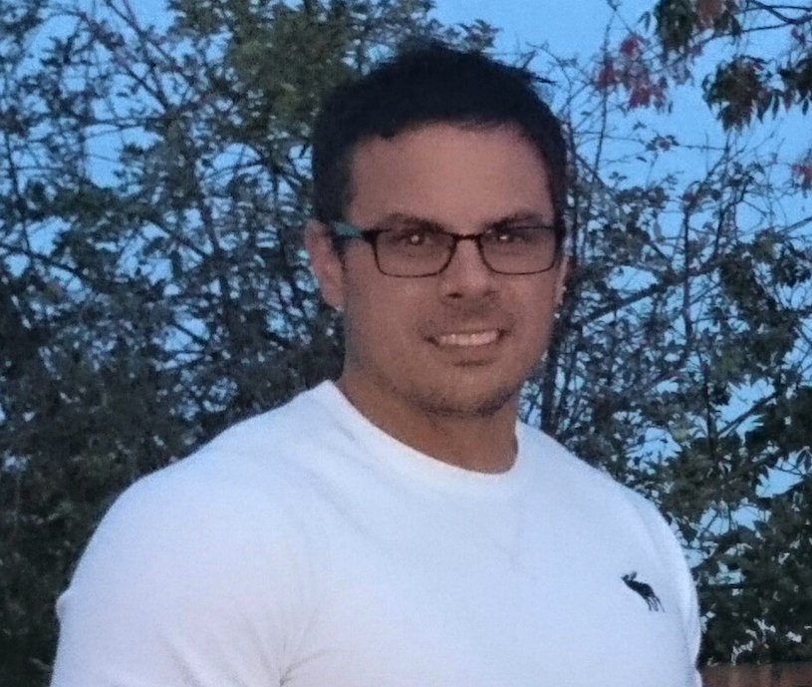
MACHINE PROGRAMMING Research (MPR)
Lead: Justin Gottschlich, Intel Labs
Principal Scientist, Director of Machine Programming Research
Adjunct Assistant Professor, University of Pennsylvania
Steering Committee Chair, ACM Machine Learning and Programming Languages (MAPL) Symposium
Chair & Executive Director of AI R&D, Industrial Board for PRECISE Center for Safe AI, U. of Pennsylvania
Principal Investigator & Co-Founder, Intel/NSF CAPA Research Center
Led research for Intel’s first hybrid SW/HW transactional memory system for Haswell TSX processors
PhD in Computer Engineering, 60+ publications/patents, 90+ patents pending (mostly in AI)
Sponsors: | Pradeep Dubey, Intel Senior Fellow Geoff Lowney, Intel Senior Fellow Pranav Mehta, Intel Labs SSR VP Rich Uhlig, Intel Senior Fellow

Slide 38
Huge Thank You (1)!
Joe Tarango – PI, inventor/researcher/architect/developer of RAAD
Pradeep Dubey, Justin Gottschlich, MPR Team – Intel Labs Machine Programming Research, amazing collaboration with the labs, we couldn’t have done this without them.
NSF/Intel Partnership on Computer Assisted Programming for Heterogeneous Architectures (CAPA)
Data Lake/Axon – Kathryn Carruthers, Nitin Jain (IT)
MPR
Fangke Ye
Shengtian Zhou
Niranjan Hasabnis
NSG
Randal Eike
Andy Sainz
Phuong Tran
Alberto Sanchez
We got by with a lot of help from our friends! Thank you!
Notes:
Presenter: Joe

Slide 39
Huge Thank You (2)!
Professors
Justin Gottschlich - Penn
Philip Brisk - University of California, Riverside
Eammon Keogh – University of California, Riverside
Abdullah Mueen – University of New Mexico
Michael Spear – Lehigh University
Interns
Daniel Garces – Colombia, Harvard
Tyler Woods – University of California, Riverside
Rogelio Macedo – University of California, Riverside
PanteA Zardoshti – Lehigh University
Andrea Chamorro – Colorado University
Sungkeun Kim – Texas A&M University
Stella Cao – University of Chicago
Brad MacDonald – Penn, Lockheed Martin, Tesla
Zachery Zimmerman – University of California, Riverside, Google
We got by with a lot of help from our friends! Thank you!
Notes:
Presenter: Joe

Slide 40
Questions & Answers
The additional content is included to provide additional context and answers to potential questions.
The notes on the slides are to provide context for offline reading.
Please feel free to setup 1:1s to get deeper detail into any particular items.
We embrace the inclusion of additional ideas or approaches, so please feel free to discuss additions in follow up meetings.
“DellEMC will need to work closely with Intel to advance capabilities that will allow out of band telemetry features to support a spectrum of usage scenarios that have differentiating value. The usage scenarios include: known good state determination, advanced diagnostics, predictive failure identification, workload performance measurement and optimization, failure mode cause analysis, and autonomic management to list a few. Additionally, Intel support for a framework and capability that enables DellEMC embedded instrumentation and management to select and optimize telemetry acquisition and optimization for Intel provided components will enable a win-win situation where DellEMC compute platform offerings can target and tune the platform telemetry for specific environments and solutions.”
Elie Jreij VP, Fellow (DELL)

Slide 41
Appendix Material

Slide 42

RAAD MP Path-Finding
Technical: Joseph Tarango, Intel Memory Solutions
Principal Investigator, Rapid Automation-Analysis for Developers
Adjunct Assistant Professor Electrical and Computer Engineering (ECE), University of Colorado – Boulder
Advanced Computer Architecture, Technical Writing for Patents, and NSF/Research Publication Writing
Advising and teaching Ph.D./M.S. students only
ECE Industry Advisor, University of Colorado – Boulder
Persistent Memory Hub Lead, Intel/NSF CAPA Research Center
Intel Core Arithmetic Scientist
Company wide mentor
PhD/MS in Computer Science and Engineering, BS Computer Engineering, AS Physics, AS Mathematics
14+ publications/patents
10+ patents pending
Classification of patents is a mixture AI, Arithmetic, Automation, CPU, Embedded, Memory, & System
Sponsors: | Jim Baca, Intel Principal Engineer Dan Elmhurst, Intel Vice President Frank Hady, Intel Fellow
RAAD = Rapid Automated-Analysis for Developers
MP = Machine Programming

